Slide 1

Green Pace
Security Policy Presentation
Developer: Bryan Chan

Slide 2
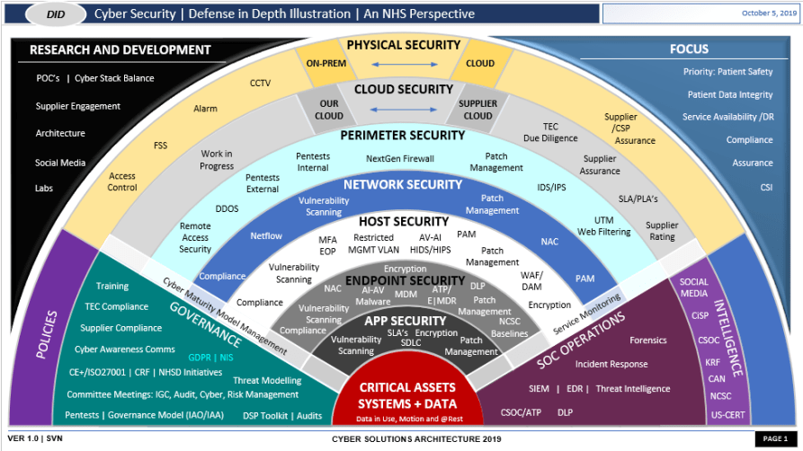
OVERVIEW: DEFENSE IN DEPTH
This security policy contains the following standards:
      Data Type
      Data Value
      String Correctness
      SQL Injection
      Memory Protection
      Assertions
      Exceptions
      Correct Integer Type
      Arrays
      Input Output (closed file)
        The follow policy satisfies every one of the project’s security needs.
According to the Fortinet article, “What Is Defense In Depth?” (n.d.), defense in depth is: “[...]a strategy that leverages multiple security measures to protect an organization's assets.” (Fortinet, n.d.). In other words, more than one security solution is used in conjunction, in order for the best security policy possible.

Slide 3
THREATS MATRIX
Likely IDS-00-J: SQL Injection (P18) MEM-30-C: Memory Protection (P18) ERR-56-CPP: Exceptions (P9) | Probable MSC-52-CPP: Data Value (P8) ARR-36-C: Arrays (P8)
Low priority DCL-03-C: Assertions (P1) INT-35-C: Correct Integer Type (P2) | Unlikely STD-001-CPP (HIGH) EXP-58-CPP: Data Type (P4) FIO-74-C: String Correctness (P6) DCL-03-C: Assertions (P1) INT-35-C: Correct Integer Type (P2) FIO-46-C: Input Output (closed file) (P4)

Slide 4
10 PRINCIPLES
Validate Input Data
  IDS-00-J: SQL Injection (P18)
  ERR-56-CPP: Exceptions (P9)
  STD-001-CPP (HIGH)
  EXP-58-CPP: Data Type (P4)
  INT-35-C: Correct Integer Type (P2)
Heed Compiler Warnings
  MEM-30-C: Memory Protection (P18)
  EXP-58-CPP: Data Type (P4)
Architect and Design for Security Policies
  ERR-56-CPP: Exceptions (P9)
Keep It Simple
  MSC-52-CPP: Data Value (P8)
Default Deny
  MSC-52-CPP: Data Value (P8)
Adhere to the Principle of Least Privilege
  IDS-00-J: SQL Injection (P18)
Sanitize Data Sent to Other Systems
  ARR-36-C: Arrays (P8)
  MEM-30-C: Memory Protection (P18)
  FIO-74-C: String Correctness (P6)
  FIO-46-C: Input Output (closed file) (P4)
Practice Defense in Depth
  IDS-00-J: SQL Injection (P18)
Use Effective Quality Assurance Techniques
  DCL-03-C: Assertions (P1)
  ERR-56-CPP: Exceptions (P9)
Adopt a Secure Coding Standard
  ERR-56-CPP: Exceptions (P9)
  IDS-00-J: SQL Injection (P18)
Heed Compiler Warnings

Slide 5
CODING STANDARDS
Data Type [EXP58-CPP.]
  Pass an object of the correct type to va_start
Data Value [MSC-52-CPP]
  Value-returning functions must return a value from all exit paths functions must return a value from all exit paths
String Correctness [FIO-47-C. ]
  Use valid format strings
SQL Injection [IDS-00-J. ]
  Prevent SQL injection
Memory Protection [MEM-30-C ]
  Do not access freed memory
Assertions [DCL-03-C]
  Use a static assertion to test the value of a constant expression
Exceptions [ERR-56-CPP]
  Guarantee exception safety
Correct Integer Type
  Use correct integer precisions
Arrays [ARR-36-C]
  Do not subtract or compare two pointers that do not refer to the same array
Input Output (closed file) [FIO-46-C]
  Do not access a closed file

Slide 6
ENCRYPTION POLICIES
Encryption in flight
  According to Sabrina Lupșan in the Cyscale article, “Types of Encryption for in Motion, in Use, at Rest Data” (2022), encryption at rest involves data that has arrived at its destination, but is not used (Lupșan, 2022). This policy can be applied by adding an encryption algorithm to encrypt data that has been received, but not used. Although the data is not used, its contents should still be encrypted, due to the risk of it being accessed due to a data breach.
Encryption at rest
  Sabrina Lupșan, in the previously mentioned Cyscale article (2022), describes encryption in motion (flight), as involving data that is moved from different locations (Lupșan, 2022). Encryption in flight can be implemented by encrypting data, regardless of its destination. It is possible for security attackers to intercept data when it is in transit. Therefore, every data that is traveling should be encrypted.
Encryption in use
  Lupșan, in the same Cyscale article, writes that encryption in use deals with data that is accessed and used (Lupșan, 2022). Encryption in use will be implemented by encrypting data that is used after arriving successfully at its destination. This will prevent data from being accessed by unauthorized users.

Slide 7
TRIPLE-A POLICIES
Authentication
  According to the Fortinet article, “What Is Authentication, Authorization, And Accounting (AAA) Security?” (n.d.), the first part of the Triple-A framework, authentication, involves: “[…] a user providing information about who they are.” (Fortinet, n.d.). Authentication can be implemented by providing every user with a token, which will serve as an identifier. This is needed in order to provide the users with a proof of identity, which will prevent impostors from accessing the owner’s account. Authentication is usually done whenever a new user has been created.
Authorization
  The previously mentioned Fortinet article (n.d.), describes authorization in the following: “[d]uring authorization, a user can be granted privileges to access certain areas of a network or system.” (Fortinet, n.d.). This second part of the Triple-A framework will be implemented, by granting users with certain privileges. By doing so, unauthorized activity within the program is prevented.
Accounting
  The same Fortinet article (n.d.) writes that accounting involves keeping track of every user activity (Fortinet, n.d.). Accounting can be implemented by having the program keep a log of a user’s every activity, whether they have logged in, or have accessed or made changes to a particular database. By accounting for every time a user has accessed the system, the system administrator is able to monitor for any suspicious activity, as well as make a determination on an attacker’s identity.

Slide 8
Unit Testing

Slide 9
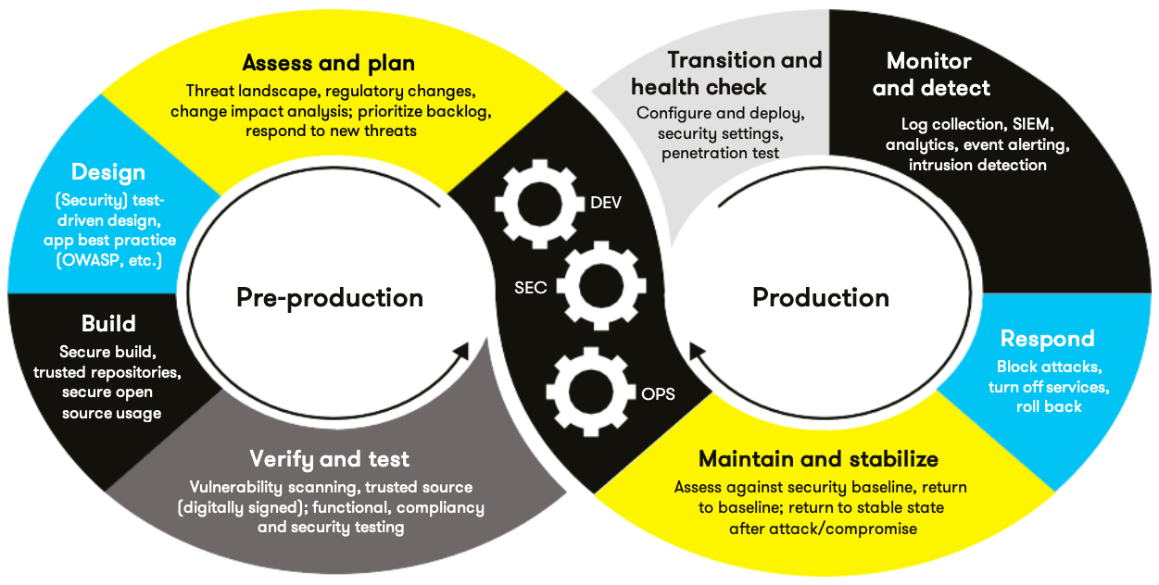
AUTOMATION SUMMARY

Slide 10
TOOLS
  The DevSecOps process:
    1) Assess and plan
    2) Design
    3) Build
    4) Verify and test
    5) Transition and health check,
    6) Monitor and detect,
    7) Respond,
    8) Maintain and stabilize
Automation is a very important tool
Automation would be very effective in the fourth phase of the DevOps process (Verify and test)
Polyspace Bug Finder

Slide 11
TOOLS
For automation to be effectively used for testing, the developer can use unit tests.
By having an automated testing system, the developer can verify that the program meets all of its requirements, by testing for every possible unit case.
The importance of automation tools can be found in the tenth coding standard: “[ARR-36-C]: Do not subtract or compare two pointers that do not refer to the same array”.

Slide 12
RISKS AND BENEFITS
If the implementation of the security measure is delayed, then the system runs the risk of being infiltrated.
A security breach could result in financial loss, as well as the loss of personal data.
As a result, the system’s/company’s reputation is damaged

Slide 13
RECOMMENDATIONS

Slide 14
CONCLUSIONS

Slide 15
REFERENCES
Confluence. (n.d.). SEI cert C coding standard. Retrieved December 22, 2024, from https://wiki.sei.cmu.edu/confluence/collector/pages.action?key=c
Fortinet. (n.d.). What Is Authentication, Authorization, And Accounting (AAA) Security? Retrieved December 22, 2024, from https://www.fortinet.com/resources/cyberglossary/aaa-security
Fortinet. (n.d.). What Is Defense In Depth? Retrieved December 22, 2024, from https://www.fortinet.com/resources/cyberglossary/defense-in-depth
Lupșan, S. (2022, August 9). Types of encryption for in motion, in use, at rest data. Cyscale. https://cyscale.com/blog/types-of-encryption/

